Slide 1


Slide 2
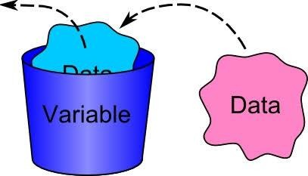

VARIABLES IN R
olakunle4impact

Slide 3

Variables in R
A variable is a characteristics of an individual in a population, the value of which can differ between entities within that population.
Types of Variable
Numeric Variable: This is one whose observations are naturally recorded as numbers. They are of two types:
a. Continuous: They can be recorded as any value in some interval, up to any number of decimal. e.g 15.12mm.
b. Discrete: It takes only distinct numeric values – and if the range is restricted, then the numbers of possible values is finite. For example, it doesn’t make sense to observe 15.245 heads if you are to observe the number of heads in a 20 flip of a coin.

Slide 4
Categorical Variable: Like some discrete variables, categorical variables takes only one of a finite number of possibilities. Unlike discrete variables, however, categorical observations are not always recorded as numeric values.
There are two types of categorical variables. They are:
a. Nominal: Those that cannot be logically ranked. e.g sex.
Sex has two categories. The order of these categories is irrelevant.
b. Ordinal: They are variables that can be logically ranked. e.g drug dosage with possible values of low, medium and high.
The values can be ordered in either increasing or decreasing amount depending on the nature of the research.

Slide 5

Variables in R
Variables are nothing but reserved memory locations to store values.
A valid variable name consists of
letters, numbers and the dot or
underline characters.
The variable name starts with a
letter or the dot not followed by a
number.
olakunle4impact

Slide 6
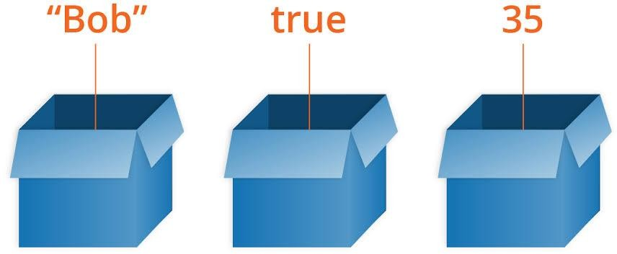
Variable Assignment
Variable Assignment
The variables can be assigned values using leftward, rightward and equal to operator.
The values of the variables can be printed using print() or cat()function. The cat() function combines multiple items into a continuous print output.

Slide 7

PRACTICAL SESSION

